Slide 1


Don Bosco Institute of Technology
Department of Electronics and Communication Engineering
Project Title –Traffic Control System using IOT for Adaptive Ambulance
Project Associates
Apoorva M -1DB20EC007
Jayashree A R-1DB20EC038
Guided By Prof. SURESHA H S Associate professor Dept. of ECE, DBIT

Slide 2
CONTENTS
ABSTRACT
INTRODUCTION
LITERATURE SURVEY
PROBLEM STATEMENTS
MOTIVATION
OBJECTIVES
METHODOLOGY
HARDWARE AND SOFTWARE REQUIREMENTS
APPLICATION
ADVANTAGES
LIMITATIONS
CONCLUSION
RESULT
FUTURESCOPE
REFERENCES

Slide 3
ABSTRACT
With the increase in the number of automobiles in urban cities, the number of accidents has increased manifold. Hence, the need for ambulances is increasing at an alarming rate. In order to increase the survival rates of the patients, an efficient communication of ambulances with the hospital and routing of the ambulances at the signal posts is very essential. Hence, the proposed architecture is distributed in nature. The system not only provides effective communication between the ambulance and the hospital but also helps the ambulance send the signal to nearby traffic signal posts to open up so that the ambulance can easily pass through saving ample amounts of time.
Keyword: Adaptive Ambulance, intelligent traffic monitoring system, Internet of Things, smart city.

Slide 4
INTRODUCTION
A smart ambulance traffic monitoring system using Internet of Things (IoT) technology is a solution that aims to optimize ambulance operations and improve emergency medical services (EMS) by leveraging the capabilities of IoT devices.
IoT technology provides a means to collect, analyze, and utilize real-time data from various sources to enhance traffic management, resource allocation, and situational awareness for EMS providers.
The background of using IoT in a smart ambulance traffic monitoring system can be traced to the increasing challenges faced by EMS providers in urban areas.

Slide 5
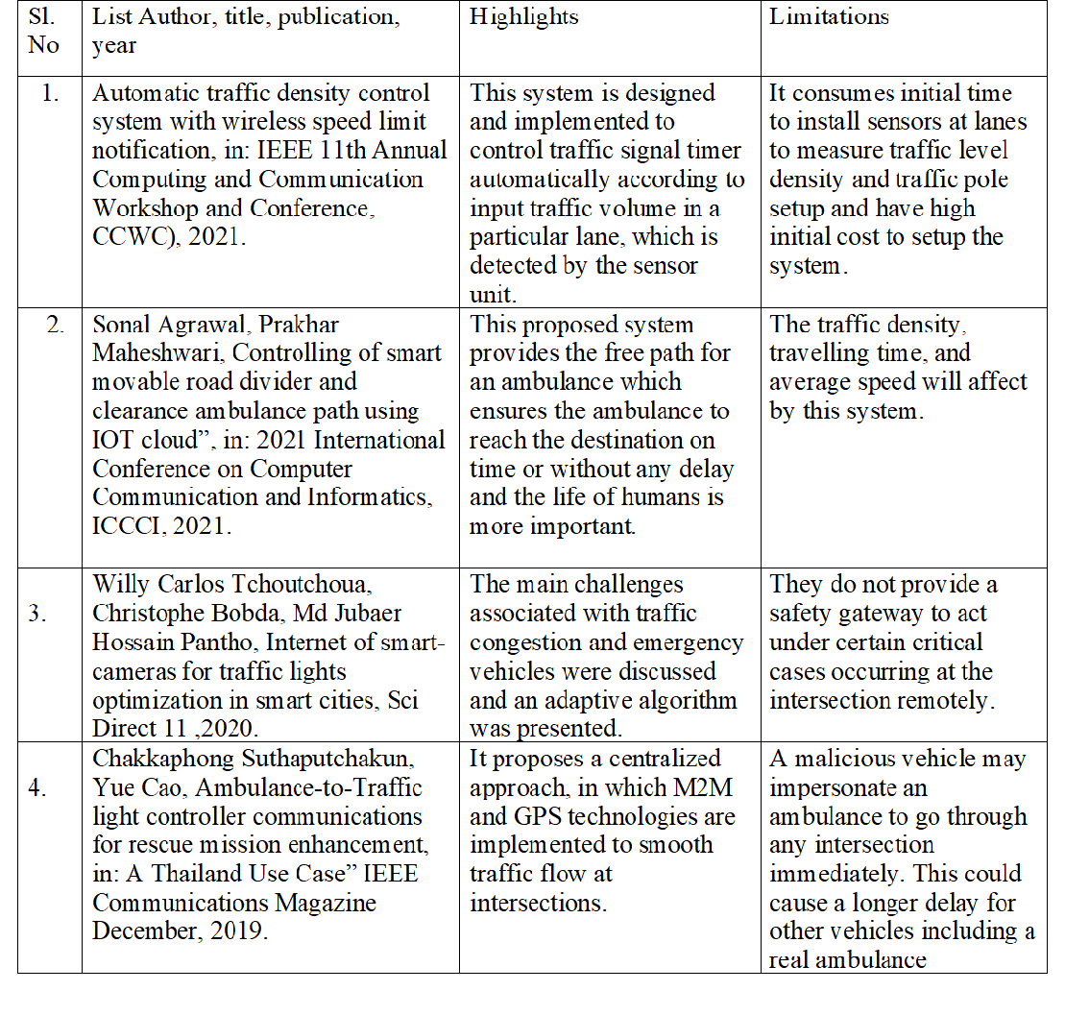
LITERATURE SURVEY

Slide 6
PROBLEM STATEMENT
Long range transmission between signal poles.
Receiver efficiency at the hospital.
Logging data and files on a collective server.
Speed into consideration (Shortest available storage).
Consistency into consideration (Main storage).

Slide 7
MOTIVATION
The motivation behind adaptive ambulance traffic monitoring system is to improve emergency medical services (EMS) and enhance patient outcomes. The system leverages advanced technologies, such as Internet of Things (IoT) devices, data analytics, and real-time traffic monitoring, to optimize ambulance operations and reduce response times in urban areas. Here are some key motivations for implementing a smart ambulance traffic monitoring system: Saving lives, Enhancing traffic management, Improving resource allocation, Enhancing situational awareness, Enhancing patient experience. In summary, the motivation behind a smart ambulance traffic monitoring system is to optimize ambulance operations, reduce response times, and improve patient outcomes during medical emergencies.

Slide 8
OBJECTIVES
• To develop and implement a strategy for reducing traffic congestion.
• Use the RFID technology for easy clearance of emergency vehicle.
• To detect the traffic density using IR sensors.
• Emergency Vehicles can be tracked based on their entry and exit points.

Slide 9
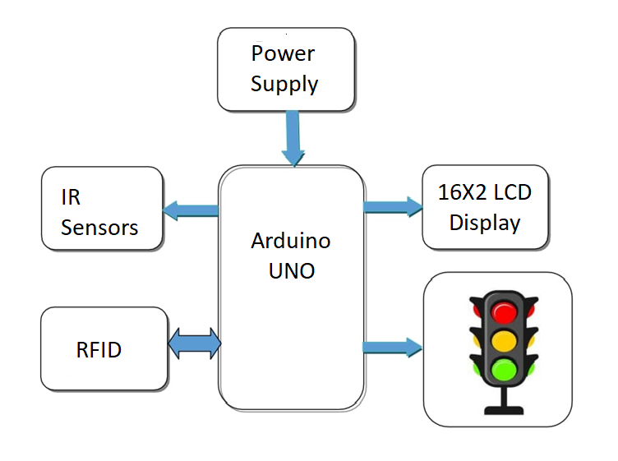
METHODOLOGY
The main controlling unit of this system is ARDUINO UNO, which is connected with IR sensors to sense the signals.
This system consist of RFID as per the requirement for Arduino can control it.
This unit consists of Arduino UNO, RFID, IR Sensor, Power supply, 16x2 LED Display and small LED lights.

Slide 10
HARDWARE AND SOFTWARE REQUIREMENTS
HARDWARE
SOFTWARE
Arduino UNO
Power Supply
IR Sensors
RFID
16X2 LCD Display
Small LED lights
Embedded C
Arduino IDE

Slide 11
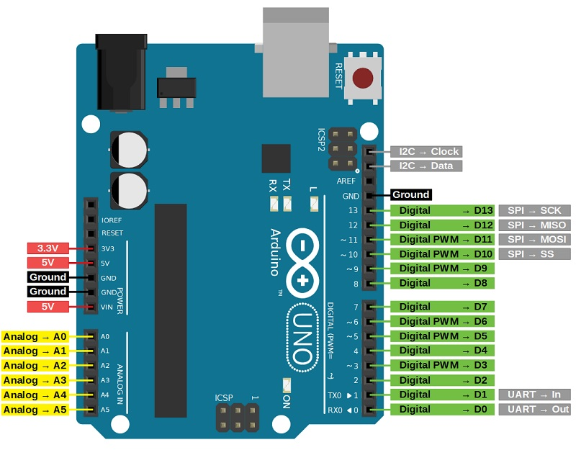
ARDUINO UNO
It is a firm that creates and produces single-board
microcontrollers and microcontroller kits for
creating digital devices, as well as an open-source
hardware and software project. The board has 14
digital I/O pins (six capable of PWM output),
6 analog I/O pins, and is programmable with
the Arduino IDE (Integrated Development
Environment), via a type B USB cable. The
boards have serial communications interfaces,
some of which support USB (Universal Serial
Bus), which are also used to load programs.

Slide 12
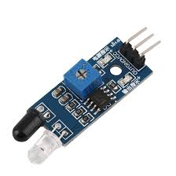
IR SENSORS
An IR transceiver, also known as an infrared
transceiver, may transmit and receive infrared
data. An IR transceiver, then, is a transmitter
and a receiver that are contained in the same
unit and share circuitry.

Slide 13
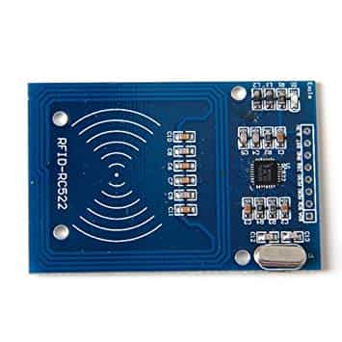
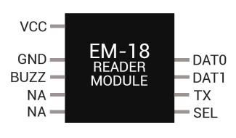
RFID
Radio-frequency identification (RFID)
uses electromagnetic fields in order
to automatically recognize and track
tags attached to things. A tiny radio
transponder, a radio receiver, and a
radio transmitter make up an RFID
system. RFID reader uses frequency
125 KHz to few MHz.

Slide 14
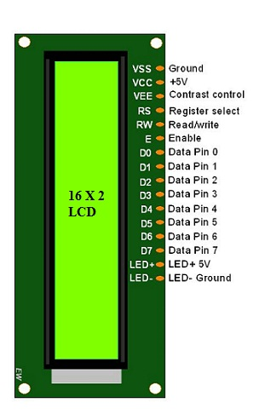
16x2 LCD DISPLAY
The term LCD stands for liquid crystal display.
It is one kind of electronic display module used
in an extensive range of applications. These
displays are mainly preferred for multi-segment
light-emitting diodes and seven segments. The
main benefits of using this module are inexpensive;
simply programmable, animations, and there are
no limitations for displaying custom characters,
special and even animations, etc

Slide 15
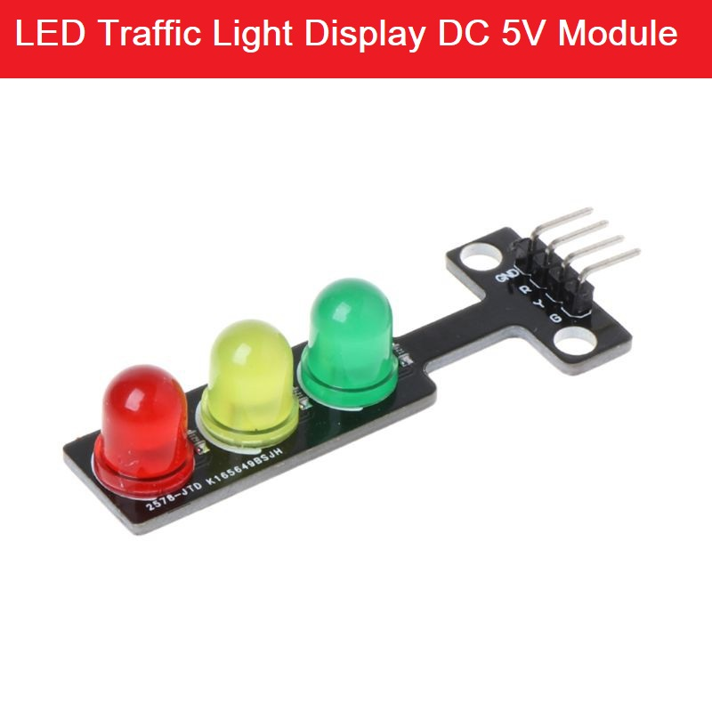
LED BULBS
When semiconductors and electron holes join again,
photons are produced. The energy needed for
electrons to pass through the semiconductor's band
gap determines the hue of the light, which
corresponds to the energy of the photons.
A layer of light-emitting phosphor or numerous
semiconductor devices can be used to create
white light.

Slide 16
APPLICATION
Implementation of IoT systems in smart city projects and urban areas to reduce traffic congestion.
Priority is given for emergency vehicle like ambulances, fire-brigades for easy movement in heavily congested area.
Reduction of time in signal clearance on each lane in urban and densely populated areas.
Data can be stored based on entry and exit points of the emergency vehicle.

Slide 17
ADVANTAGES
Benefits of Ambulance Traffic Monitoring System is as follows:
Emergency notification and coordination.
Safety hazard alerts.
Remote patient monitoring by integrating IoT devices.
Vehicle health monitoring to track ambulance maintenance.
Data analytics for post incident analysis.

Slide 18
LIMITATIONS
Coverage Limitations:There might be areas with limited or no coverage, which could lead to incomplete data or inaccurate traffic monitoring.
Dependence on Real-Time Data: The system heavily relies on real-time data, such as traffic conditions and ambulance locations.
Legal and Regulatory Considerations: Issues such as data ownership, data sharing agreements, compliance with privacy regulations, and liability in case of system failures or accidents need to be carefully addressed.

Slide 19
CONCLUSION
IR sensors and RFID is one of the technologies that can be utilized for smart transportation system thereby reducing the human effort and avoid traffic congestions, and easy movement of emergency vehicle movements.
RFID technology can also be used for tracking the emergency vehicles like ambulance, fire brigades, etc. like its entry and exit points and the particular vehicle using its registration number and RFID number.
IR sensors are best used to find the density on each lane to avoid congestions, making it easier to manipulate the signal system at each junction

Slide 20
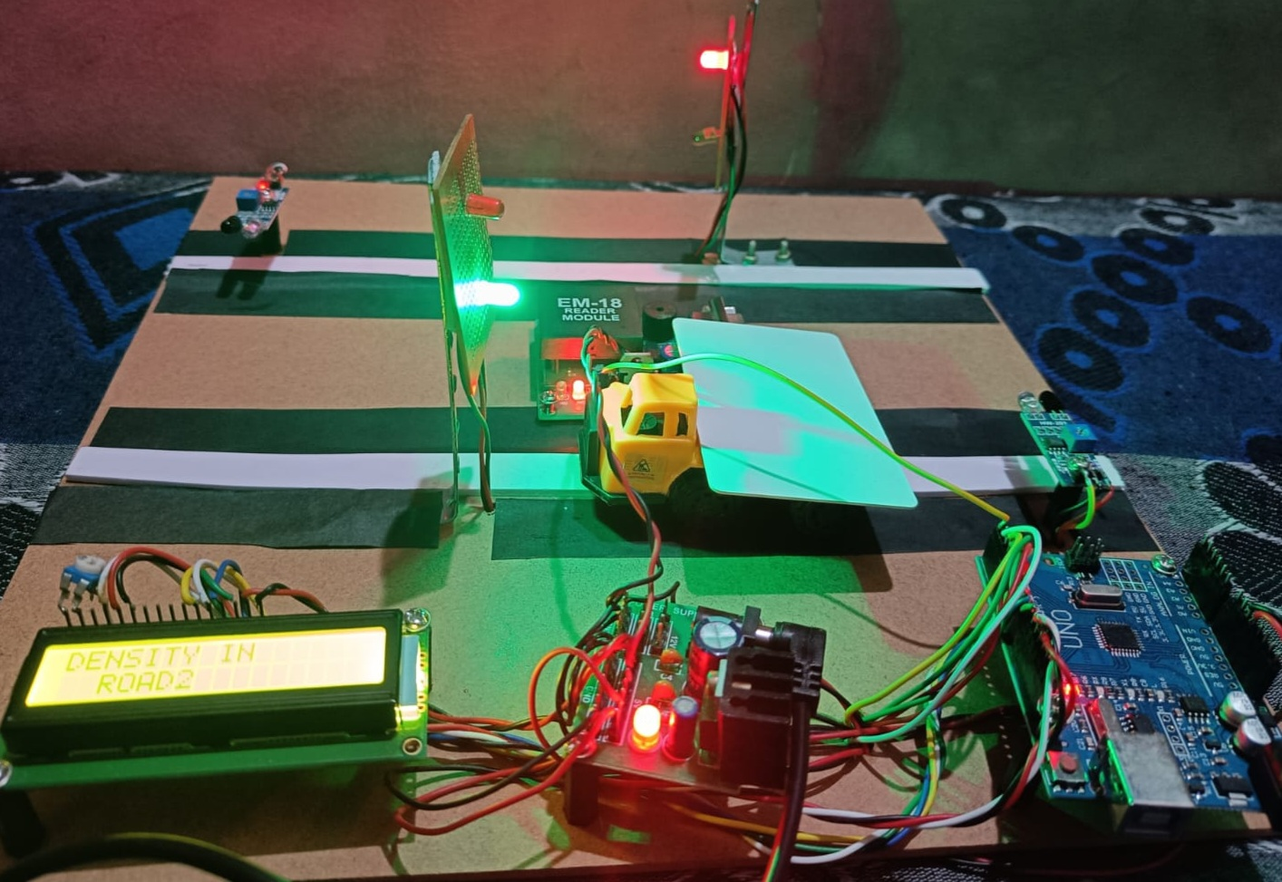
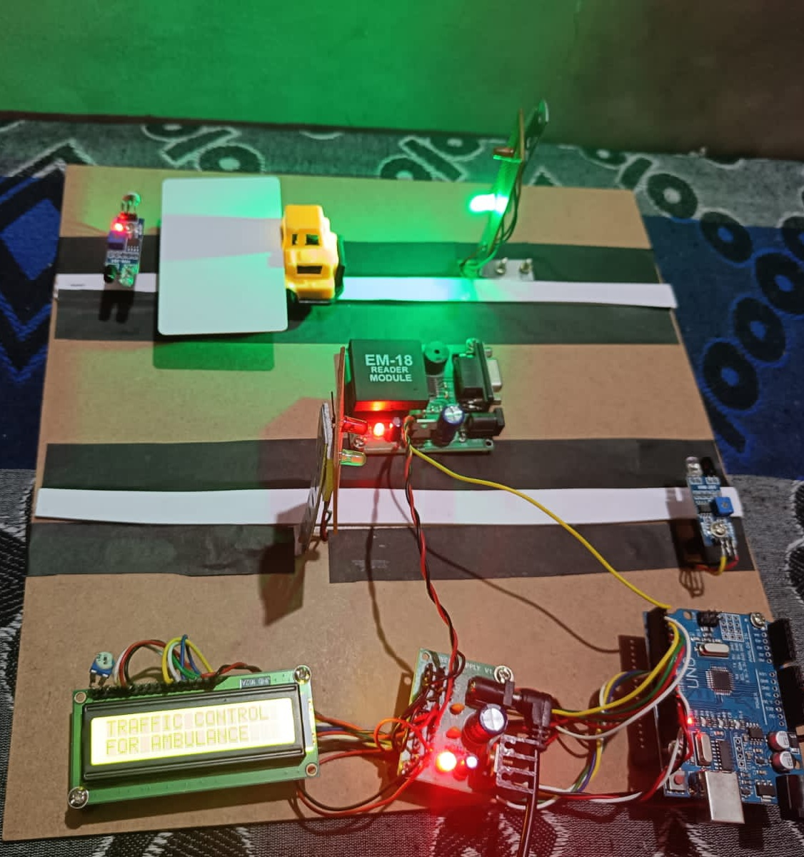
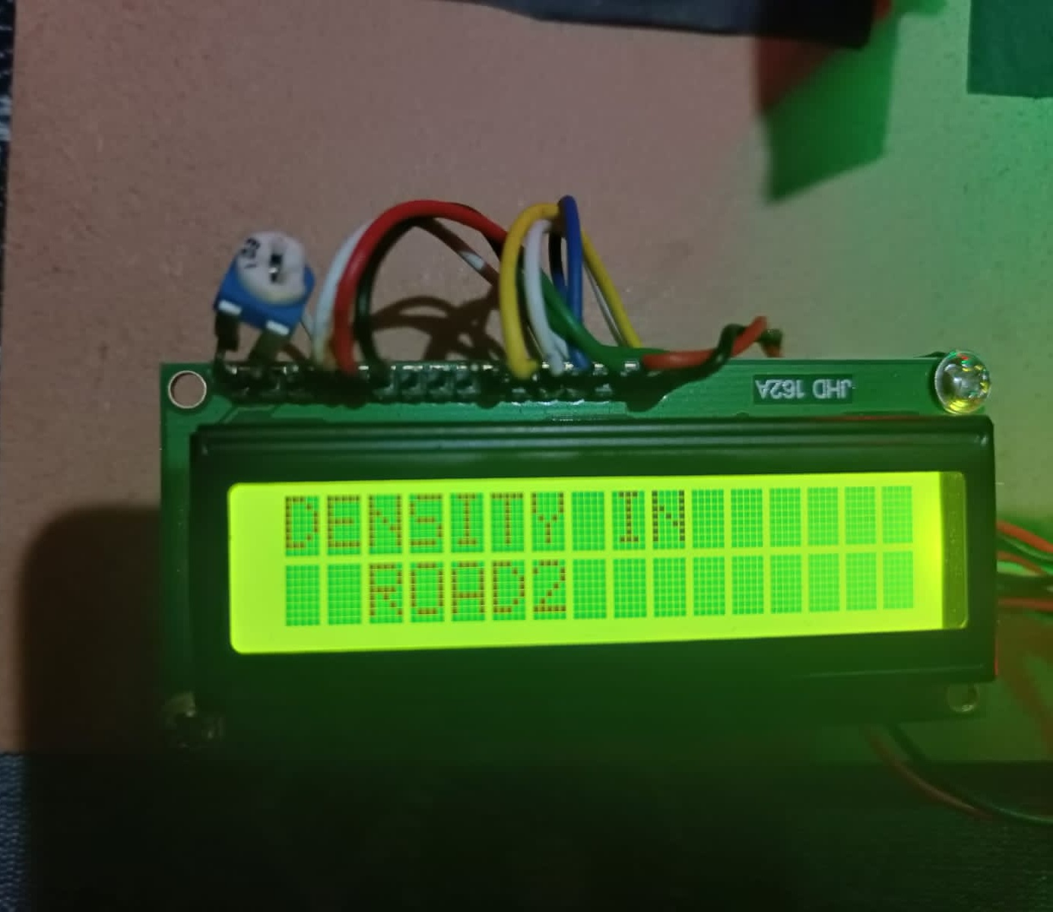
RESULT
An emergency vehicle is detected on a lane using Radio waves transmitted by RFID device and is triggered by RFID card attached to vehicle which is paired by traffic signal system, this prioritizes the traffic to get cleared at a faster rate on that lane. The data of emergency vehicle can be stored and retrieved from the database management system which carries unique RFID tags based on their entry and exit points on the traffic lanes.

Slide 21
FUTURESCOPE
The future scope of adaptive ambulance traffic monitoring system is promising, as it can greatly improve emergency medical services and enhance the overall efficiency of ambulance operations. Here are some potential advancements and benefits we can expect:Real-time traffic monitoring, Traffic signal prioritization, Integration with medical systems, Data-driven insights.
Overall, the future of traffic monitoring systems holds great potential to revolutionize emergency medical services, improving response times, patient outcomes, and the overall efficiency of ambulance operations.

Slide 22
REFERENCES
S. Mahalakshmi a,* , T. Ragunthar b , N. Veena a , S. Sumukha a , Pranav R. Deshkulkarni a, Adaptive ambulance monitoring system using IOT-Computer and Information Science-2022 www.sciencedirect.com
Automatic traffic density control system with wireless speed limit notification, in: IEEE 11th Annual Computing and Communication Workshop and Conference, CCWC), 2021.
Sonal Agrawal, Prakhar Maheshwari, Controlling of smart movable road divider and clearance ambulance path using IOT cloud”, in: 2021 International Conference on Computer Communication and Informatics, ICCCI, 2021.
Willy Carlos Tchoutchoua, Christophe Bobda, Md Jubaer Hossain Pantho, Internet of smart-cameras for traffic lights optimization in smart cities, Sci Direct 11 (2020), 100207
Chakkaphong Suthaputchakun, Yue Cao, Ambulance-to-Traffic light controller communications for rescue mission enhancement, in: A Thailand Use Case” IEEE Communications Magazine December, 2019.

Slide 23
THANK YOU

